Slide 1

Backup Basics with dbatools
Andy Levy
Database Administrator, BRi

Slide 2
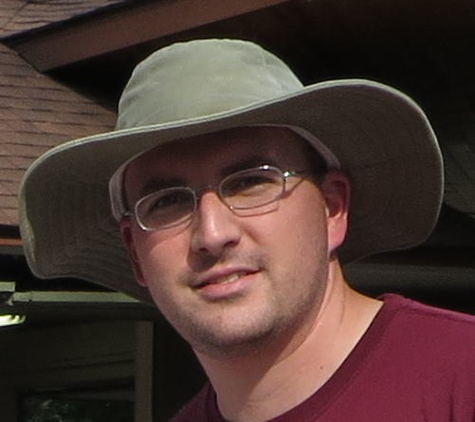




About Me
Stuff I Do
Contact
Database Administrator
dbatools contributor
User Group Leader
SQL Saturday Organizer
https://flxsql.com/
andy@flxsql.com
@alevyinroc

Slide 3

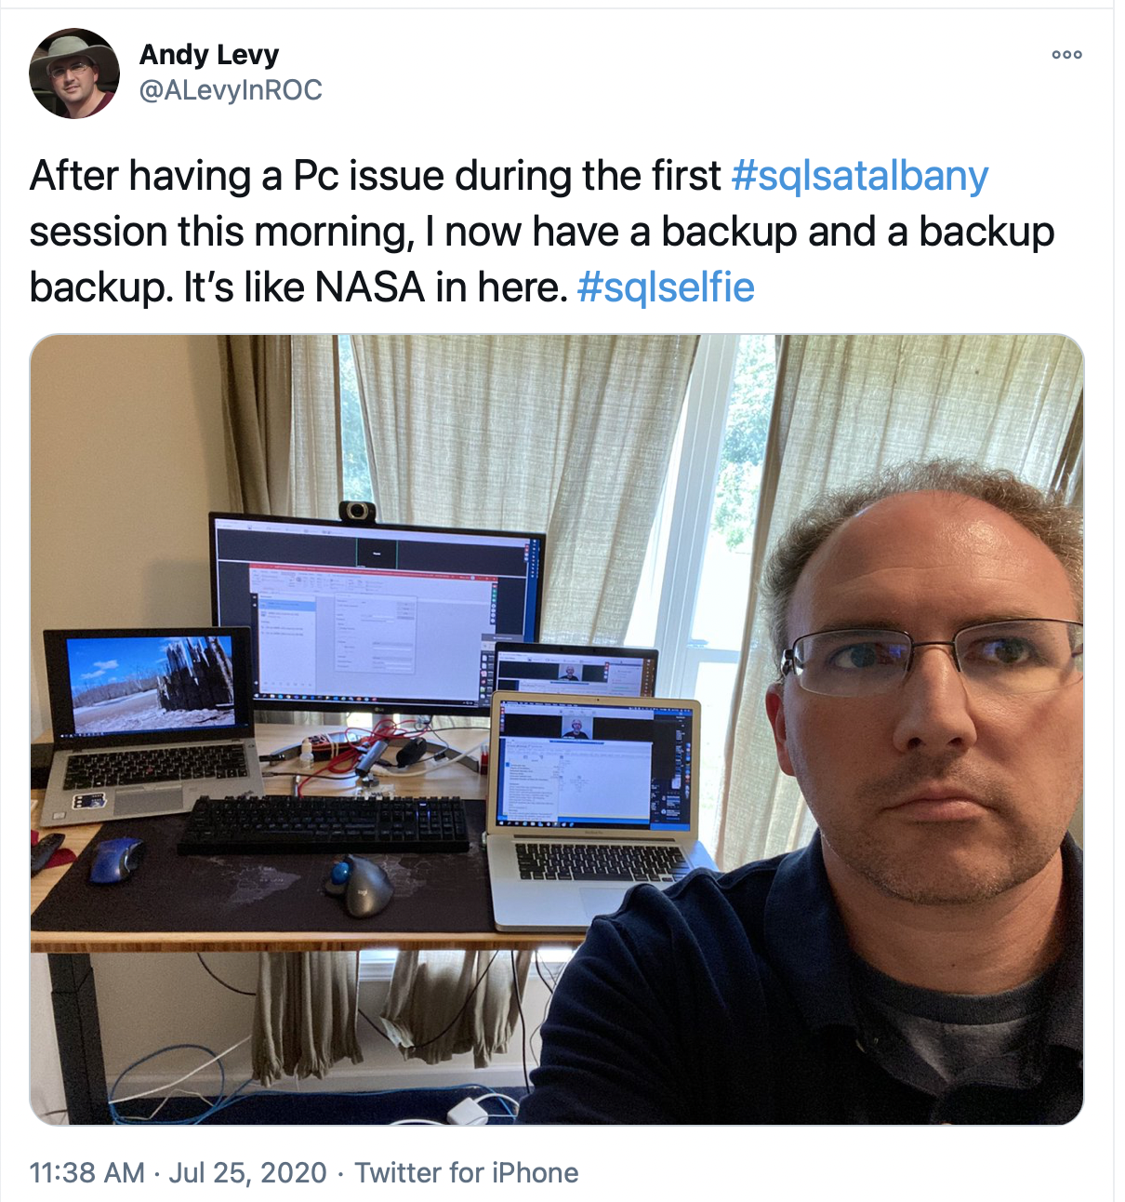
I
Really
Like Backups

Slide 4
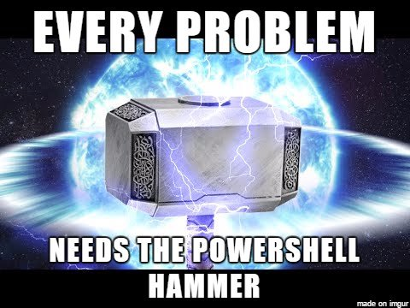
Why dbatools?

Slide 5
Why Backups?
If it’s worth having, it’s worth having a copy somewhere safe

Slide 6
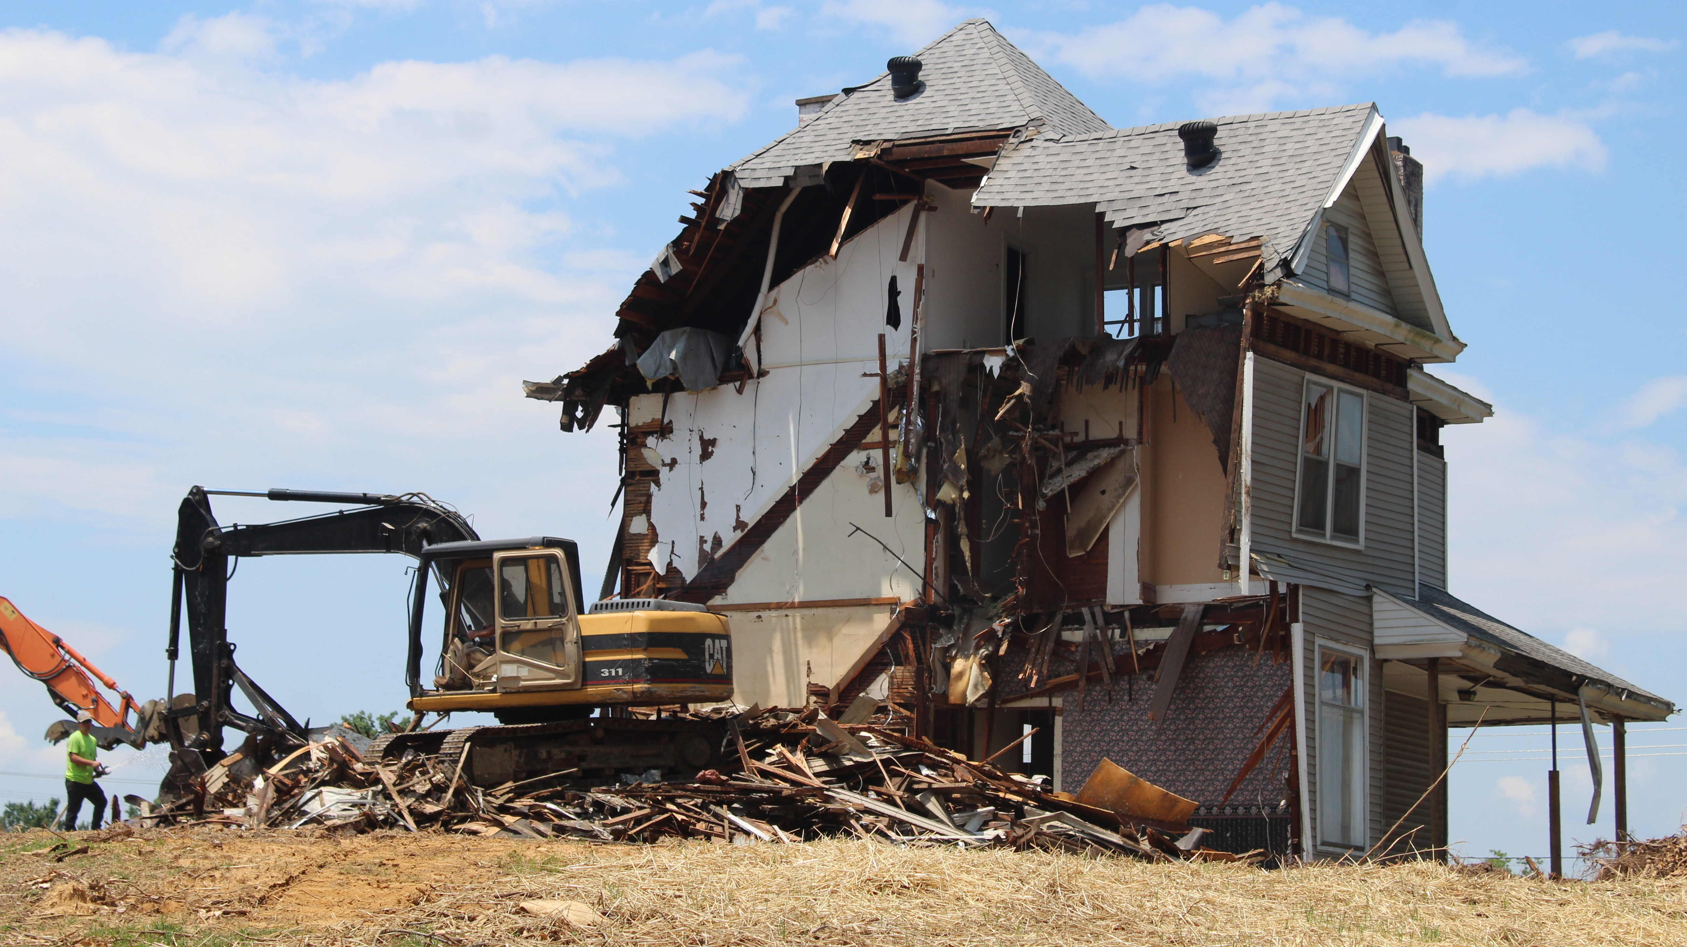
Demo Time!
Notes:
https://unsplash.com/photos/ivHVZCmm5wY

Slide 7
Thank You!
https://flxsql.com/
andy@flxsql.com
@alevyinroc

